Slide 1
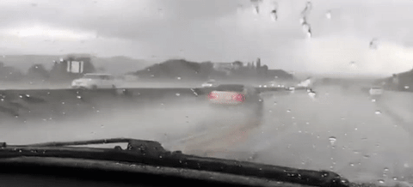
Hydroplaning: How Much Water Is Too Much?
Partnering Conference 2025
Presentation by:
Cameron Brunty, PE (KYTC)
John Meyer, PE (HMB)

Slide 2
Presentation Agenda
Relay importance of hydroplaning assessments
Provide background information and recommended values
Walkthrough how to assess hydroplaning potential on a project
Discuss mitigation strategies and potential solutions

Slide 3
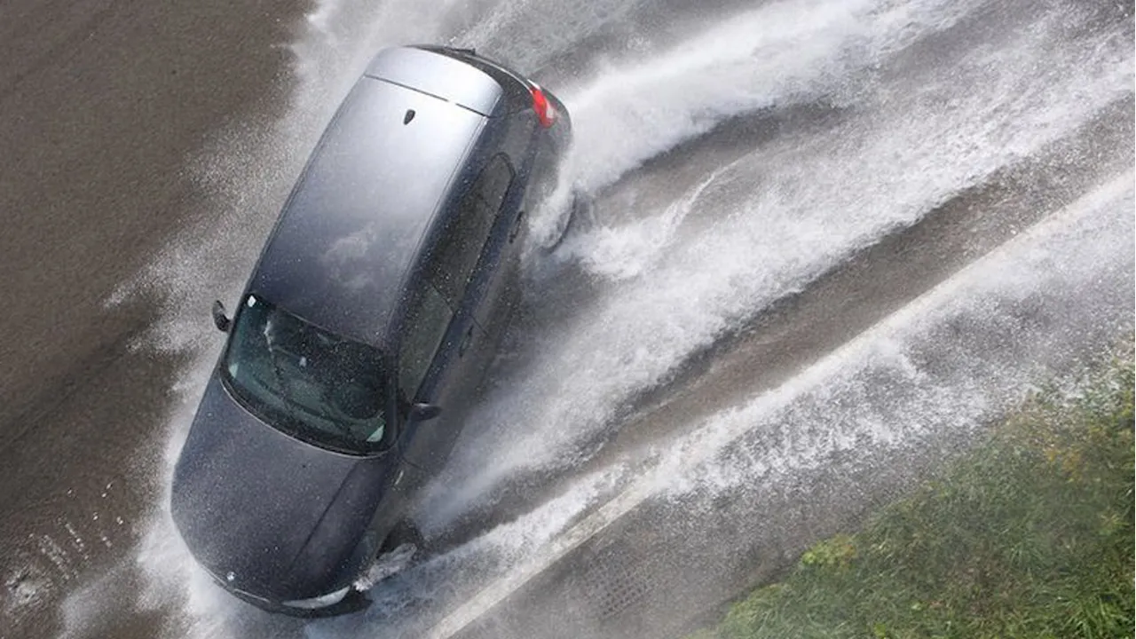
Rain Related Crash Data
574,047 rain/mist related crashes per year, approx. 10% of all vehicle crashes. (2019-2023 estimated five-year average)
219,039 rain/mist related injuries per year, approx. 9% of all vehicle injuries. (2019-2023 estimated five-year average)
2,810 rain/mist related fatalities per year, approx. 7% of all vehicle fatalities. (2019-2023 estimated five-year average)
Over 77% of weather-related crashes happen during rain or mist conditions.
How Do Weather Events Affect Roads? - FHWA Road Weather Management

Slide 4
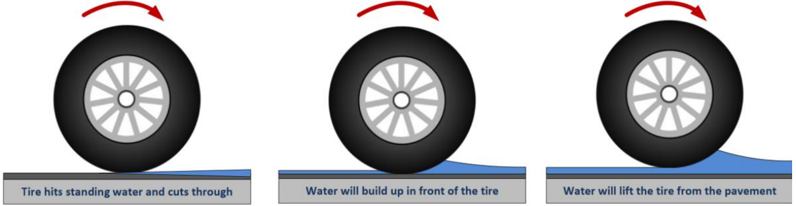
What is Hydroplaning?
(1)
Dynamic hydroplaning occurs when a vehicle’s tire encounters a greater water film thickness than that which can be pushed away by the tire, lifting the tire from the pavement, making the vehicle unstable.

Slide 5
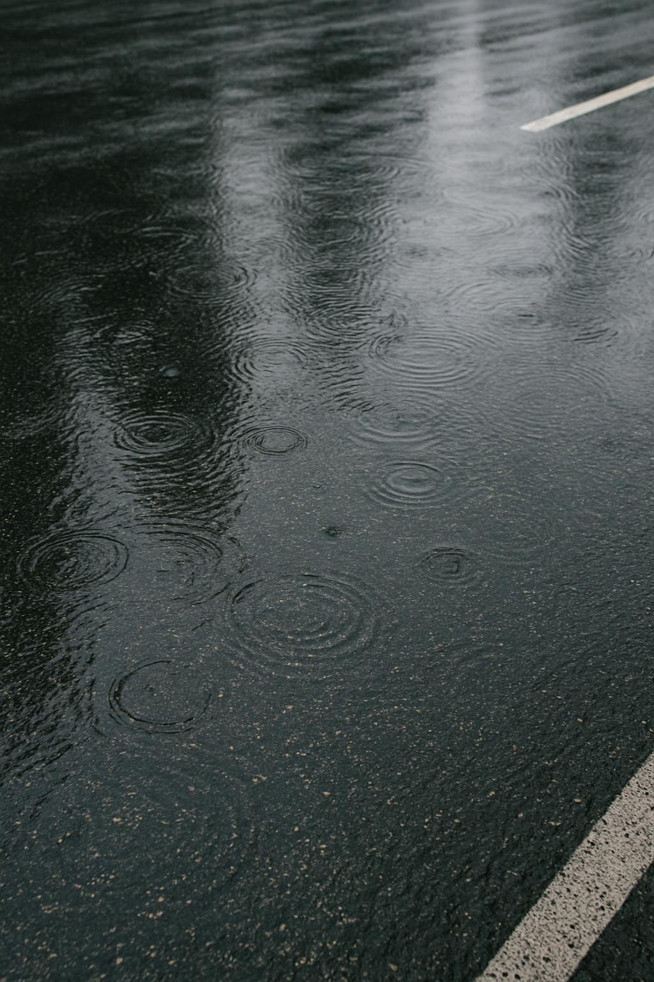
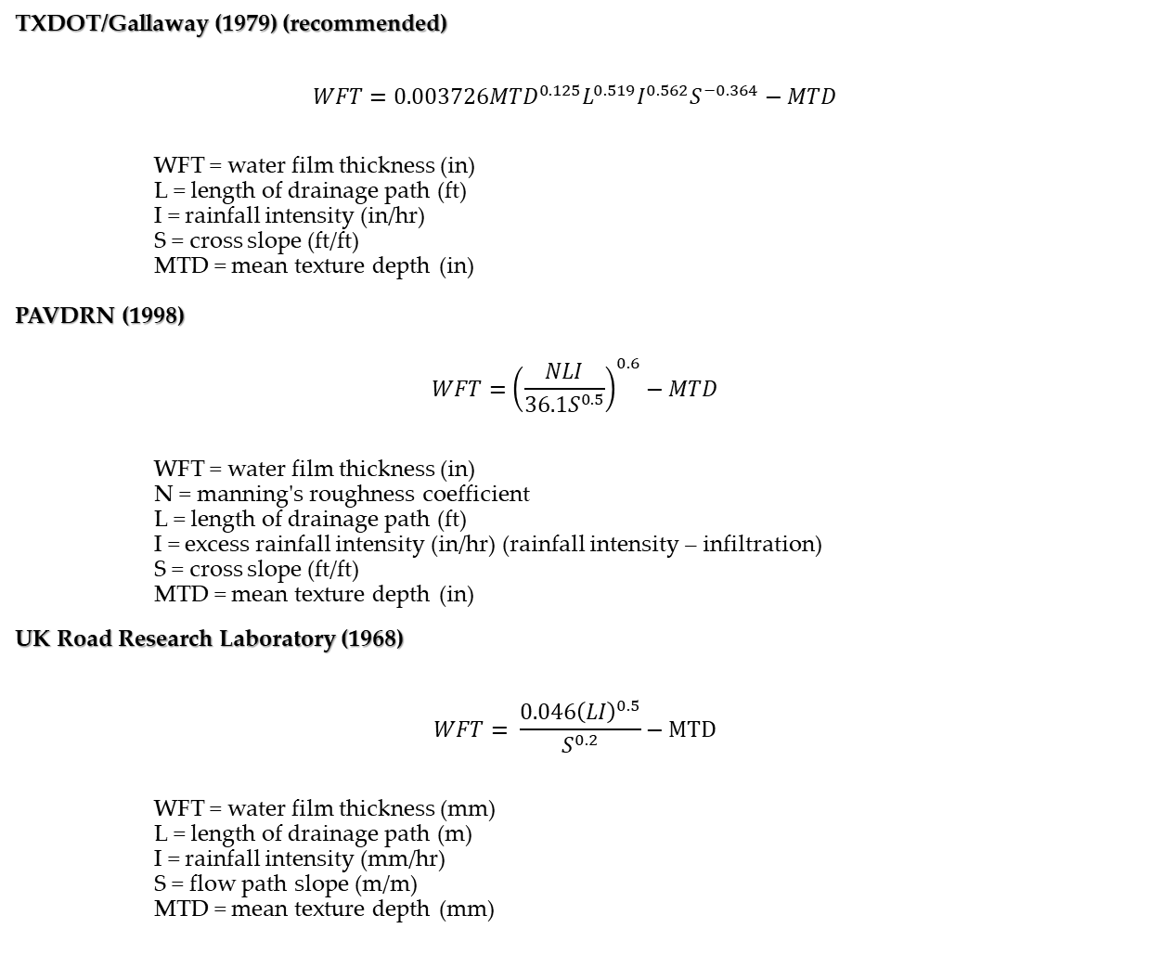
Water Film Thickness
TXDOT/Gallaway (1979) (recommended)
$$WFT=0.003726{MTD}^{0.125}L^{0.519}I^{0.562}S^{−0.364}−MTD$$
WFT = water film thickness (in)
L = length of drainage path (ft)
I = rainfall intensity (in/hr)
S = cross slope (ft/ft)
MTD = mean texture depth (in)
PAVDRN (1998)
$$WFT={\left(\frac{NLI}{36.1S^{0.5}}\right)}^{0.6}−MTD$$
WFT = water film thickness (in)
N = manning's roughness coefficient
L = length of drainage path (ft)
I = excess rainfall intensity (in/hr) (rainfall intensity – infiltration)
S = cross slope (ft/ft)
MTD = mean texture depth (in)
UK Road Research Laboratory (1968)
$$WFT= \frac{0.046{\left(LI\right)}^{0.5}}{S^{0.2}}−MTD$$
WFT = water film thickness (mm)
L = length of drainage path (m)
I = rainfall intensity (mm/hr)
S = flow path slope (m/m)
MTD = mean texture depth (mm)
The accumulation of water above the surface of the pavement, measured as a depth.
As water film thickness increases, hydroplaning potential increases.

Slide 6
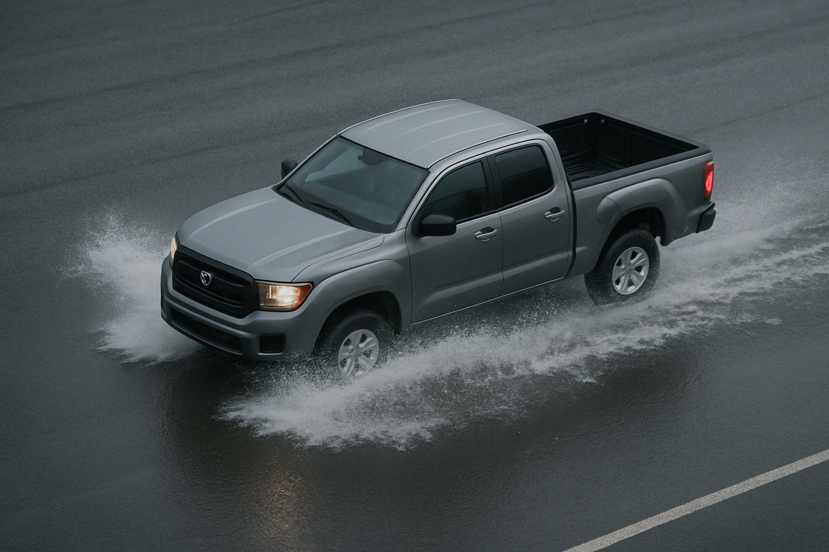
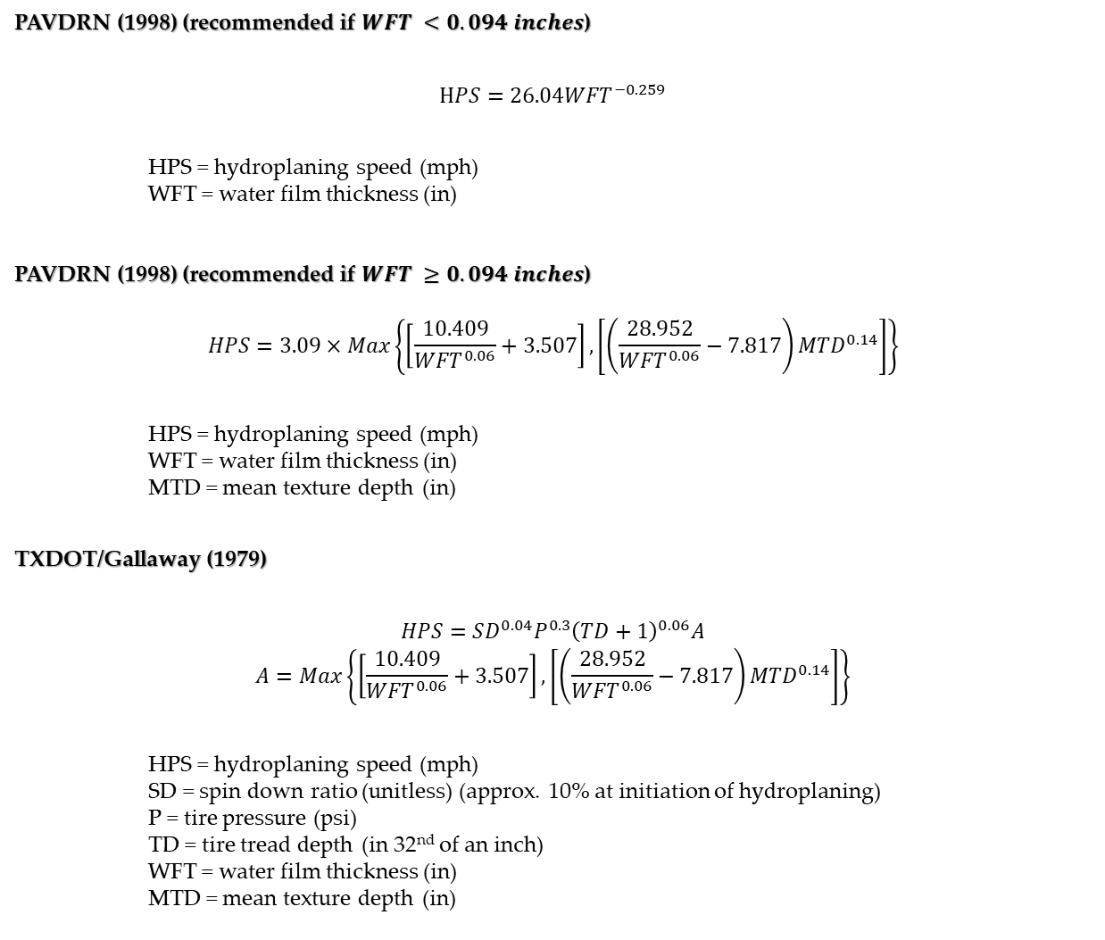
Hydroplaning Speed
PAVDRN (1998) (recommended if $WFT <0.094 inches$)
$$HPS=26.04{WFT}^{−0.259}$$
HPS = hydroplaning speed (mph)
WFT = water film thickness (in)
PAVDRN (1998) (recommended if $WFT ≥0.094 inches$)
$$HPS=3.09×Max\left\{\left[\frac{10.409}{{WFT}^{0.06}}+3.507\right], \left[\left(\frac{28.952}{{WFT}^{0.06}}−7.817\right){MTD}^{0.14}\right]\right\}$$
HPS = hydroplaning speed (mph)
WFT = water film thickness (in)
MTD = mean texture depth (in)
TXDOT/Gallaway (1979)
$$HPS=SD^{0.04}P^{0.3}{\left(TD+1\right)}^{0.06}A$$
$$A=Max\left\{\left[\frac{10.409}{{WFT}^{0.06}}+3.507\right], \left[\left(\frac{28.952}{{WFT}^{0.06}}−7.817\right){MTD}^{0.14}\right]\right\}$$
HPS = hydroplaning speed (mph)
SD = spin down ratio (unitless) (approx. 10% at initiation of hydroplaning)
P = tire pressure (psi)
TD = tire tread depth (in 32nd of an inch)
WFT = water film thickness (in)
MTD = mean texture depth (in)
The speed at which hydroplaning potential begins to increase significantly.

Slide 7
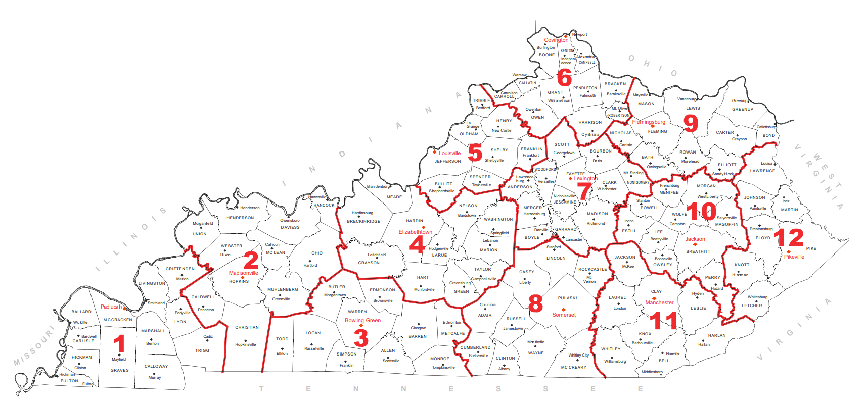
Storm Intensity
5 yr = 1.71 in
10 yr = 1.95 in
25 yr = 2.26 in
2 inch/hour is the recommended event for hydroplaning analysis.
2 inch/hour is generally a 10-year storm in the state of Kentucky.
5 yr = 1.70 in
10 yr = 1.96 in
25 yr = 2.30 in
PF Map: Contiguous US
5 yr = 1.57 in
10 yr = 1.83 in
25 yr = 2.20 in
5 yr = 1.92 in
10 yr = 2.19 in
25 yr = 2.54 in
5 yr = 1.71 in
10 yr = 1.96 in
25 yr = 2.31 in
5 yr = 1.84 in
10 yr = 2.10 in
25 yr = 2.45 in

Slide 8
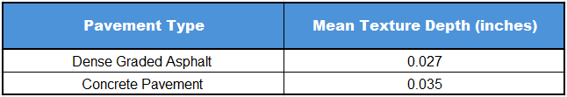
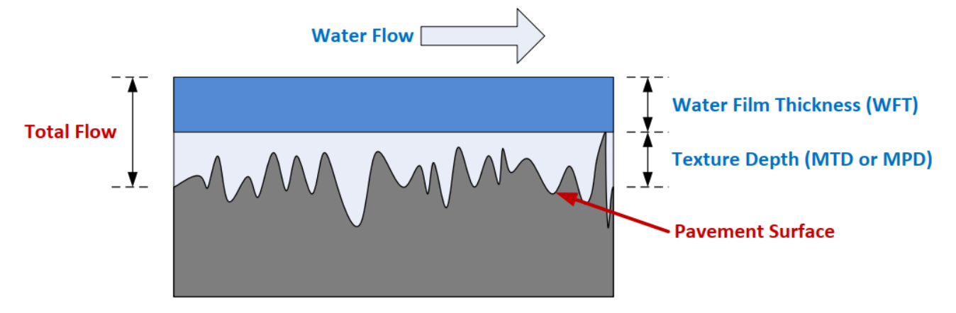
Mean Texture Depth
Mean texture depth is the measure of the average depth of the surface texture (storage) of a pavement.
See chart for different MTD pavement values. Values from NCDOT hydroplaning guidance.
(2)
(1)

Slide 9
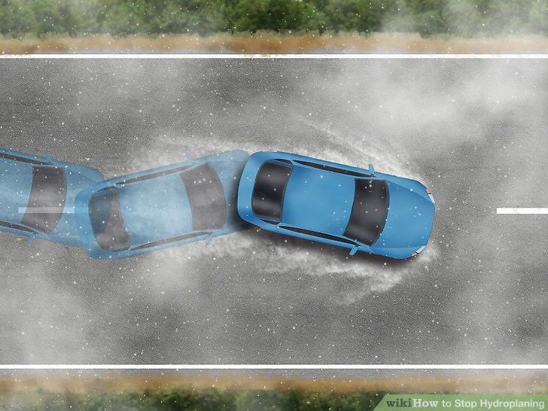
Relating WFT and HPS

Slide 10
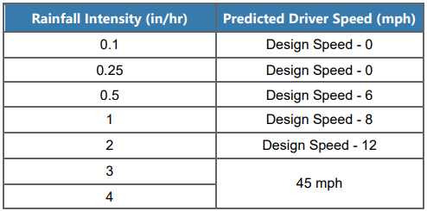
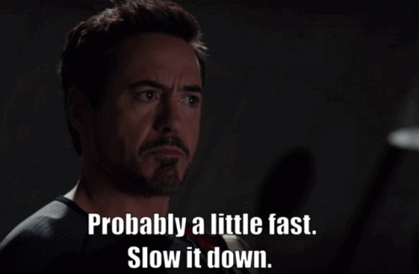

Speed Adjustments
The table indicates predicted driver speed reductions in response to different rainfall events. Essentially people start to slow down when it’s raining hard enough to lose driver visibility.
The chart is structured towards a 70-mph design speed. For other speeds, a 12-17% reduction can be applied.
The PAVDRN hydroplaning speed equation was developed in the 1970’s utilizing a tire pressure of 24 psi and smooth tires. With the introduction of modern tire tread and the increase of average psi across modern vehicles, an additional 5 mph reduction is recommended.
(3)

Slide 11
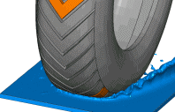
Relating WFT and HPS

Slide 12
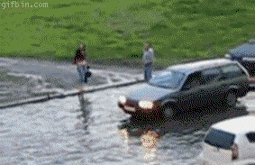
When Is Assessment Most Critical?
High speed facilities. (design speeds 65mph and greater)
Tangent sections with 36ft or more of pavement sloped in a common direction. (includes paved shoulders, gores, auxiliary lanes, etc.)
Superelevation transitions where 2 or more lanes are rotating together.
Areas where water could be entering the roadway from an outside source.

Slide 13

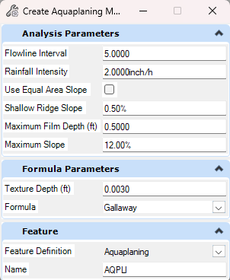
Analysis & Mitigation Process – Tool Identification
Data Driven Safety Analysis Identified Areas of Interest
Initial Screening – TopoDOT Cross Slope / Grade Report + Visual Contour Assessment
Aquaplaning Tool Exploration Visualization that strengthens design decisions
Maps water-film thickness and flow paths directly on the surface.
How the tool works derives a delta terrain (water-film thickness) and flowlines from the surface model so we see where thin films accumulate and travel across lanes.
Analysis requires a few inputs tool tested iteratively and referenced multiple studies relating water film thickness and hydroplaning on high speed facilities
The goal isn't to replace engineering judgment, its to enhance it
  Potential geometric issues diagnosed quickly
  Inform design decisions based on existing conditions as well as check proposed design

Slide 14
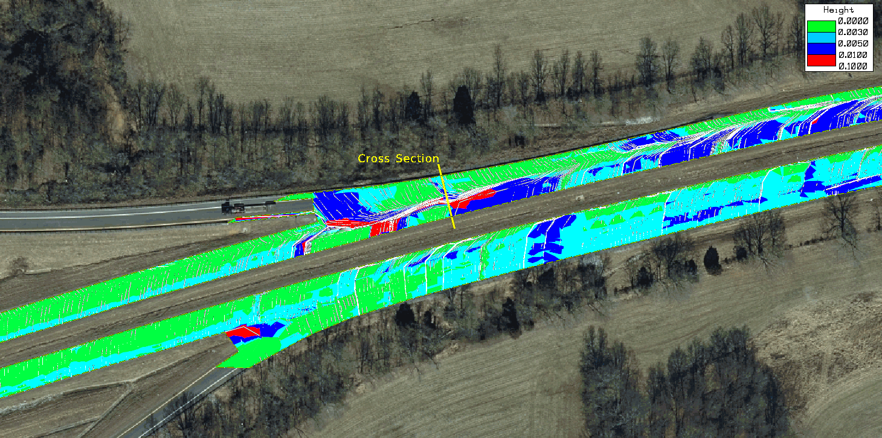
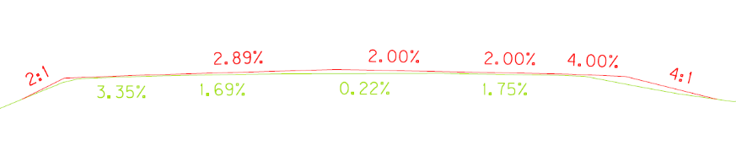
Analysis & Mitigation Process – Use Case
The existing aquaplaning run highlighted continuous runs of elevated water film thickness present in travel lanes near a superelevation transition.
The length of water film exceeding the agreed threshold is critical: short pockets in transitions may be unavoidable and less actionable, while longer, wheelpath-aligned segments signal higher risk and merit design attention/consideration.
Cross-section check at a flagged location shows a near-flat cross slope and grade, which both promote film buildup.
Rutting was noted but is addressed by planned mill and inlay, so no separate mitigation is needed in certain areas.
Existing Surface – water film threshold exceeded for significant length

Slide 15
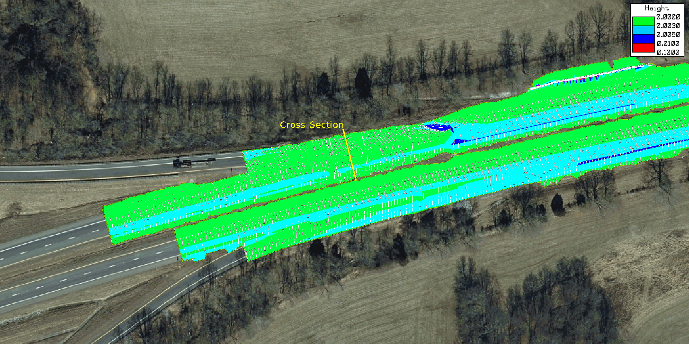
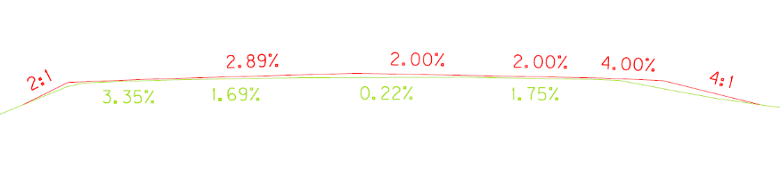
Analysis & Mitigation Process – Use Case
Use the tool as a quick design check on the proposed surface to confirm that water-film thickness no longer presents a hydroplaning concern.
Results show the film largely collapsed to low values with only short, localized pockets near transitions.
Primary fix: restore cross-slope where necessary and address length of superelevation transitions (the main cause of the long film runs).
Targeted drainage only where relevant to our interstate test cases: consider slotted drains in gore areas; median boxes apply where barrier walls exist.
Proposed Surface – long exceedance removed; short, non-actionable pockets remain

Slide 16
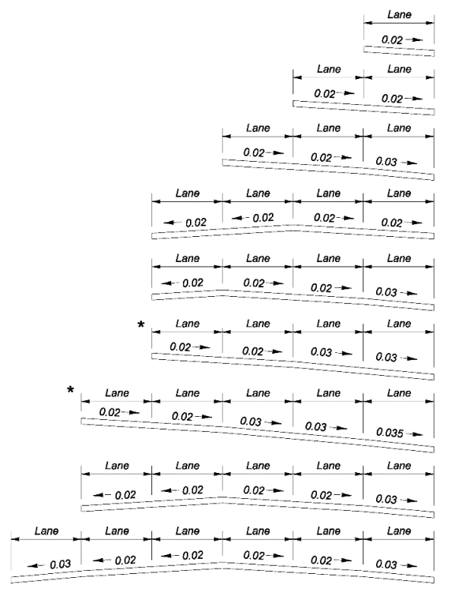
Mitigation – Increase Cross Slope
GB 2018 – 4.2.2.1 – Three or more lanes inclined in the same direction on a multilane highway, increase slope of each successive pair of lanes after the first pair from centerline.
GB 2018 – 4.2.2.1 – Cross slope increases should be between 0.5% to 1.0%.
GB 2018 – 4.2.2.1 – Cross slope should not exceed 3% in a tangent section unless there are three or more lanes in one travel direction.
GB 2018 – 4.2.2.2 – In areas of intense rainfall, cross slope may be increased to 2.5% with a corresponding crown line crossover of 5%.
GB 2018 – 4.2.2.2 – Three or more lanes in one travel direction, maximum cross slope should be limited to 4 percent.
(4)

Slide 17
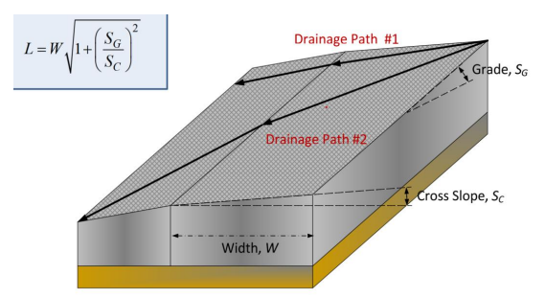
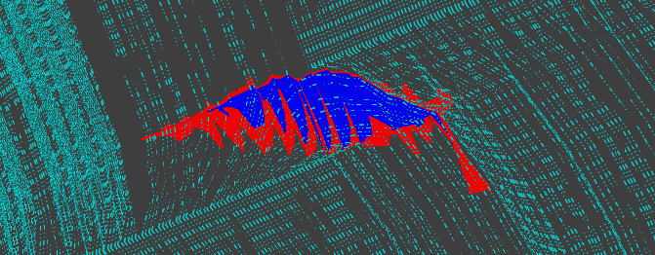

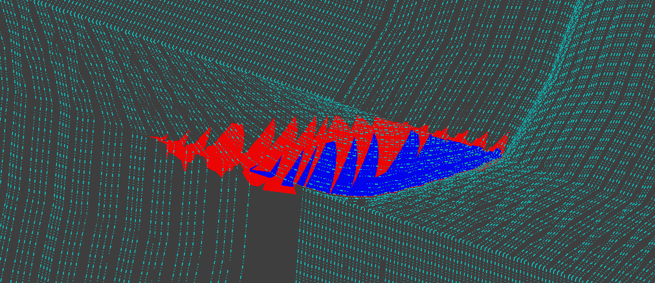
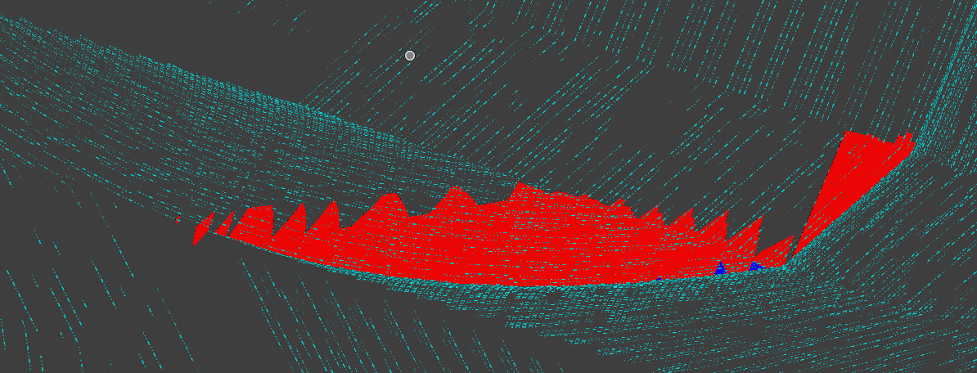
Mitigation – Adjust Longitudinal Slope
In tangent sections, flattening the longitudinal slope decreases the drainage path and aligns it more perpendicular to the edge line of the roadway.
In superelevation transitions, steepening the longitudinal grade increases the drainage path but also increases the velocity of the water decreasing the water film thickness.
(1)
Images show a 0.5% and a 2.0% longitudinal grade rotating through the zero cross slope point.

Slide 18
Mitigation – Calculate Superelevation Transition
GB 2018 – 3.3.8.2 – Desirable maximum gradient for design speeds of 50 mph and higher is 0.50%.
The tables below show runout and runoff values, calculated using a 0.50% maximum gradient versus table 3-10 values, for 1 to 5 lane configurations. (70 mph design speed and 12’ lanes)
As rotation width increases, the difference between calculated and table runout values increases. Using the calculated values decreases the length of cross slope below 0.5% in transitions.
One Lane
Two Lane
Three Lane
Four Lane
Five Lane
Calculated:
Runout | 48
Runoff | 192
Table:
Runout | 60
Runoff | 240
Calculated:
Runout | 72
Runoff | 288
Table:
Runout | 90
Runoff | 360
Calculated:
Runout | 96
Runoff | 386
Table:
Runout | 120
Runoff | 480
Calculated:
Runout | 120
Runoff | 480
Table:
Runout | 150
Runoff | 600
Calculated:
Runout | 144
Runoff | 576
Table:
Runout | 180
Runoff | 720

Slide 19
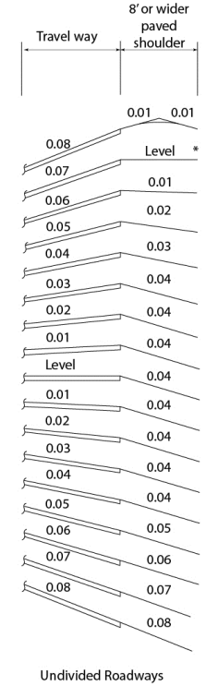
Mitigation – Apply Design Memo No. 7-24
Design Memorandum No. 7-24 HD-702.5 indicates shoulder slopes in reaction to superelevation with the intent of shedding water from the travel way until a ≥7% travel way slope is encountered.
Preventing water from entering the travel way from the shoulder decreases the drainage path length which decreases water film thicknesses, especially in superelevation transitions.

Slide 20
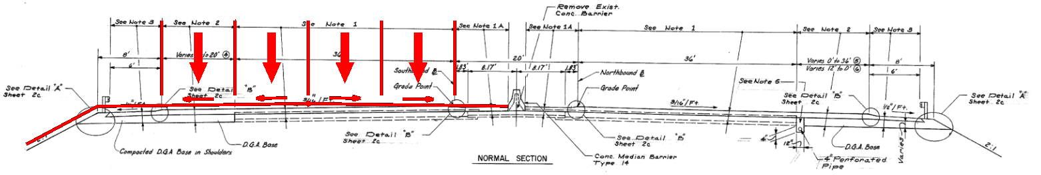
Mitigation – Changing Crown/Rotation Point
For multilane facilities, the crown/rotation point can be strategically changed to minimize pavement sloped in a common direction.
Changing crown/rotation point decreases the superelevation rotation width, decreasing transition length. (shortens length of cross slope below 0.5%)
Changing crown/rotation point sheds more water towards the median increasing drainage costs in the median.

Slide 21
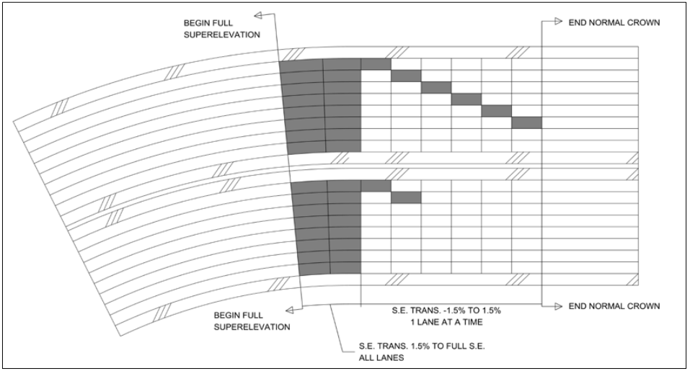
Mitigation – Stagger Superelevation By Lane
Superelevation transitions can be staggered to segment the length of drainage rollover through the zero cross slope location into smaller pieces.
Segmenting the drainage rollover paths will decrease the water film thickness through the transition.
(5)

Slide 22
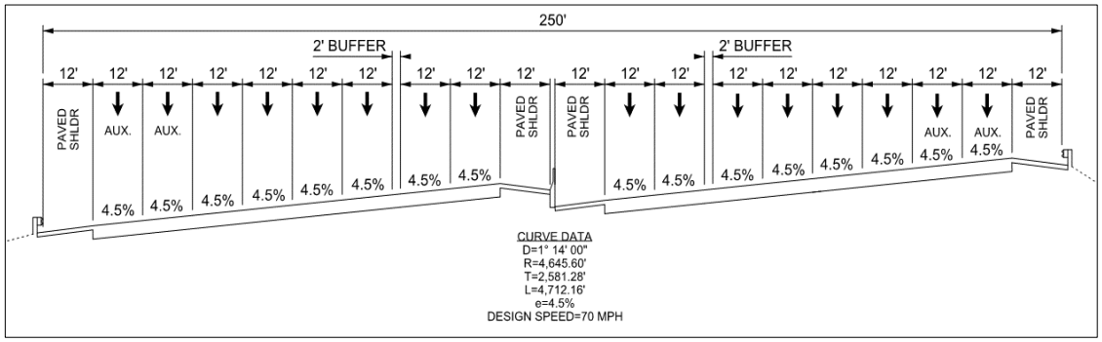
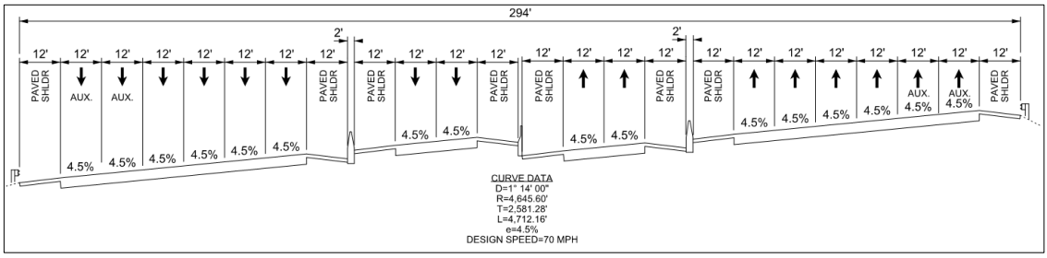
Mitigation – Add Barriers/Inlets Between Lanes
For large multilane facilities, groups of lanes in a common travel direction can be separated by barriers to strategically create a location to construct inlets before water film thickness reaches a depth of concern.
Inlets can be introduced without the construction of barriers but make maintenance operations can become more difficult.
(5)
(5)

Slide 23

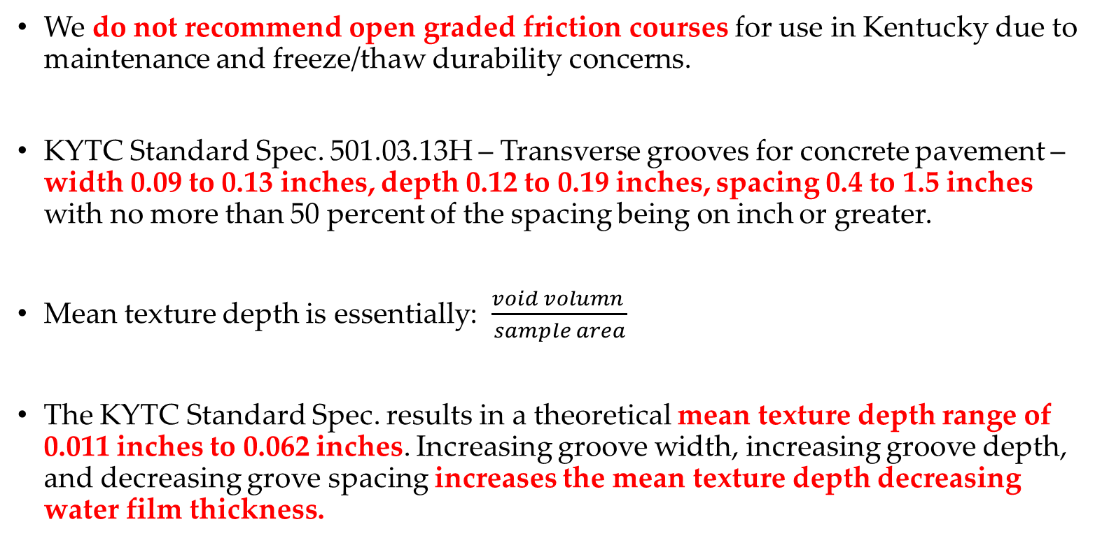
Mitigation – Changing Pavement Material
We do not recommend open graded friction courses for use in Kentucky due to maintenance and freeze/thaw durability concerns.
KYTC Standard Spec. 501.03.13H – Transverse grooves for concrete pavement – width 0.09 to 0.13 inches, depth 0.12 to 0.19 inches, spacing 0.4 to 1.5 inches with no more than 50 percent of the spacing being on inch or greater.
Mean texture depth is essentially: $\frac{void volumn }{sample area}$
The KYTC Standard Spec. results in a theoretical mean texture depth range of 0.011 inches to 0.062 inches. Increasing groove width, increasing groove depth, and decreasing grove spacing increases the mean texture depth decreasing water film thickness.

Slide 24
Mitigation strategies can not fully eliminate hydroplaning potential from roadways but can significantly decrease risk.
Assessments are made utilizing assumed generalizations and parameters to encapsulate a conservative median of drivers and conditions.
Aggressive driver behavior, poor vehicle maintenance, high intensity storms, or any deviations from the assumed generalizations and parameters could result in higher hydroplaning potential and crashes.
Performing assessments and applying strategies early in the design process is the best way for us to provide safe, efficient, and fiscally responsible transportation systems.

Slide 25

Questions?
Cameron.brunty@ky.gov
Jmeyer@hmbpe.com

Slide 26
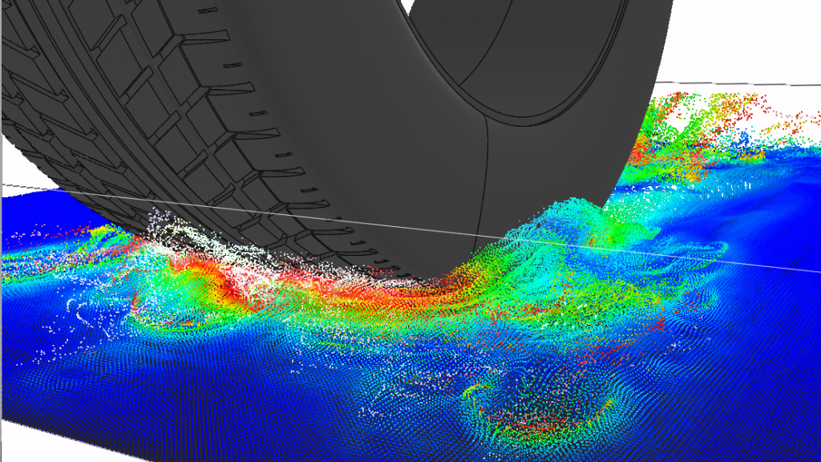
Sources
FDOT. - Enhanced Hydroloplaning Prediction Tool - Hyung S. Lee and Dinesh Ayyala - 2020
NCDOT. - Guidelines for Drainage Studies and Hydraulic Design 4.3.2.2 - 2022
FDOT. - Evaluation of Driver Behavior to Hydroplaning in the State of Florida Using Driver Simulation - Claude Villiers, Dahai Guo, and Bertho Augustin - 2012
FDOT. - Design Manual 210.2.4 - 2025
FDOT. - Hydroplaning Crash Study and Mitigation Strategies Phase II - Al-Ahad Ekram and Steven Kane - 2018

